Slide 1

Carbon Architecture

Slide 2
Why this is important
Carbon is the foundation for any WSO2 server runtime
Knowing carbon makes you thorough on 60% of any WSO2 product
Carbon basics helps you to troubleshoot any WSO2 product effectively

Slide 3
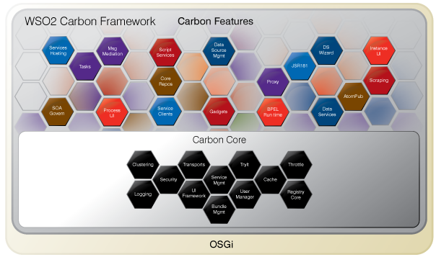
Carbon is the base

Slide 4
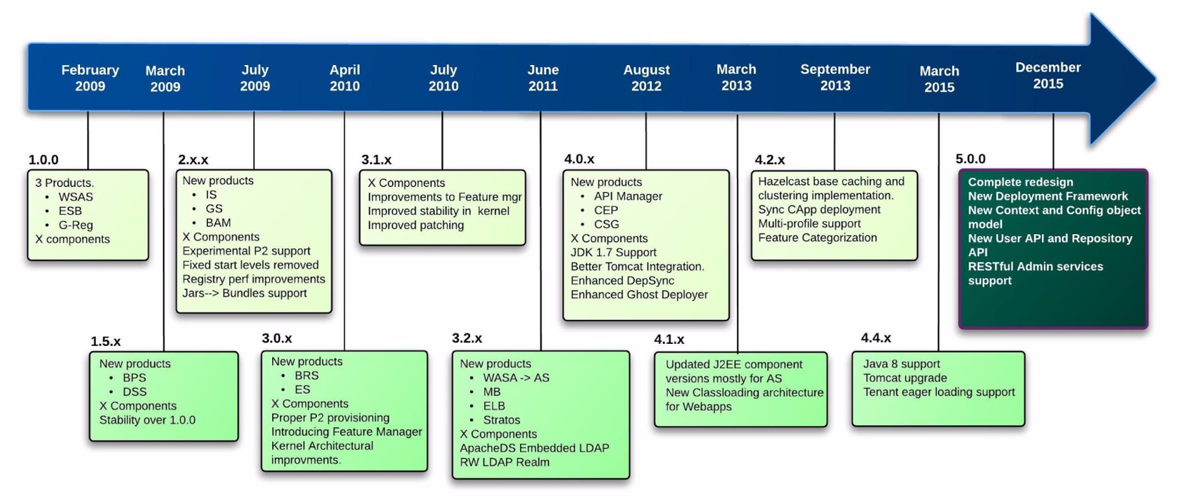
History of Carbon

Slide 5
The foundation services in Carbon
Clustering
Caching
User management
Registry
Transports
Artifact deployment
Logging
Data sources / JNDI
OSGI feature management

Slide 6
Why OSGi
Provides a comprehensive component platform
Being able to separate out the concerns and develop independently
Coarse grain functionalities
Ability to support multiple component versions

Slide 7
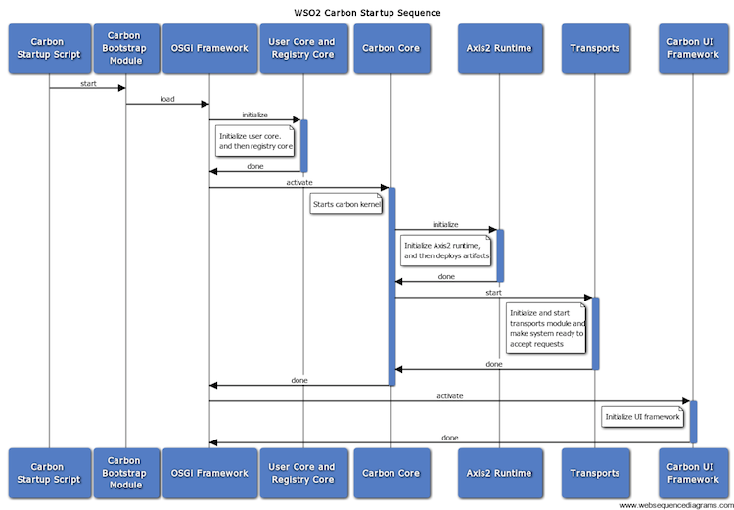
Carbon startup sequence

Slide 8
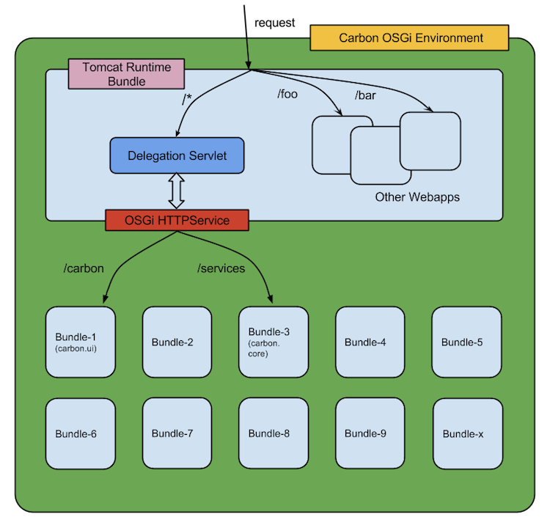
Inner architecture

Slide 9
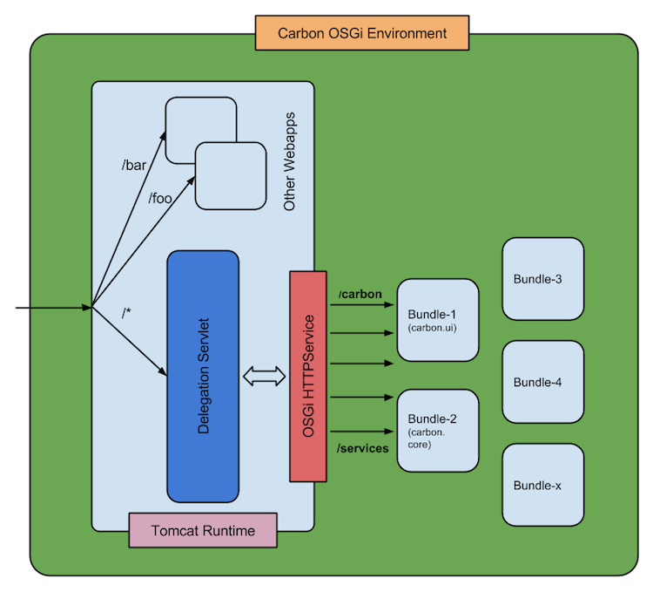
Request dispatching

Slide 10
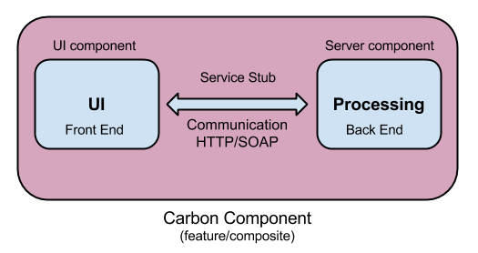
The Carbon component

Slide 11
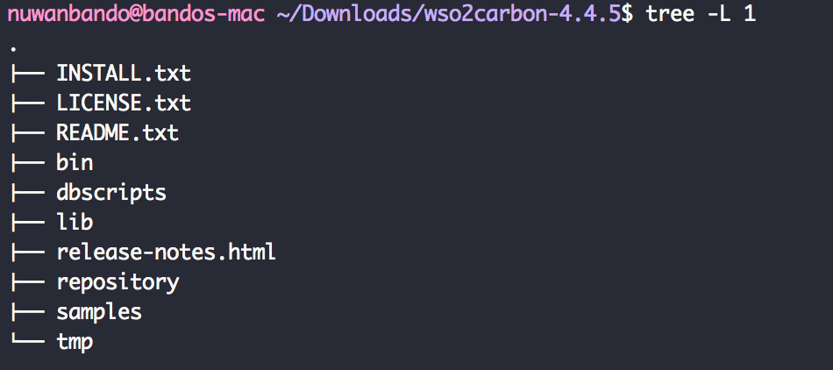
The Carbon directory structure
Common structure for all products

